Slide 1
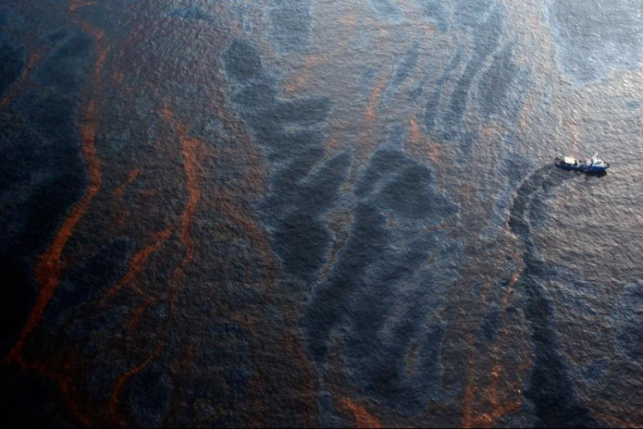
OIL SPILL
ENVIRONMENTAL SCIENCE MINOR ACTIVITY
Ananya Prasad:20BCE10093
Nishant Verma:20BCG10094
Amit Verma:20BCE10115
Navdha Kadian:20BCE10336
Kaustubh Chimote:20BCE10387

Slide 2
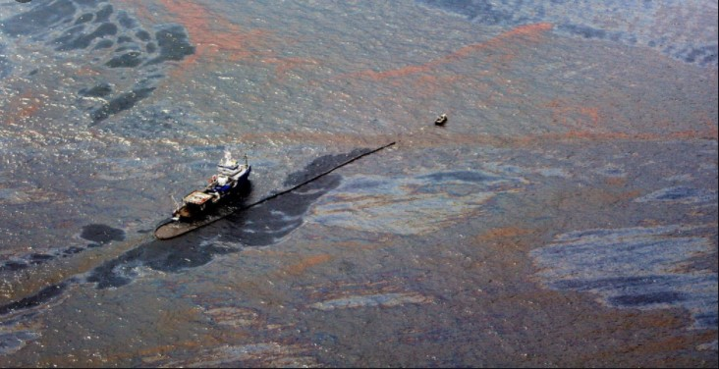
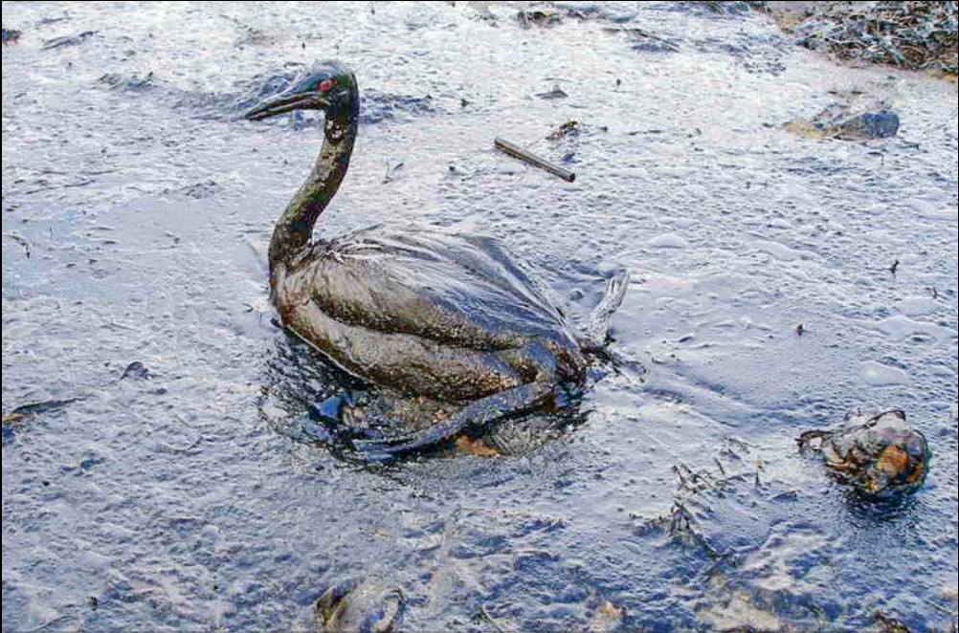
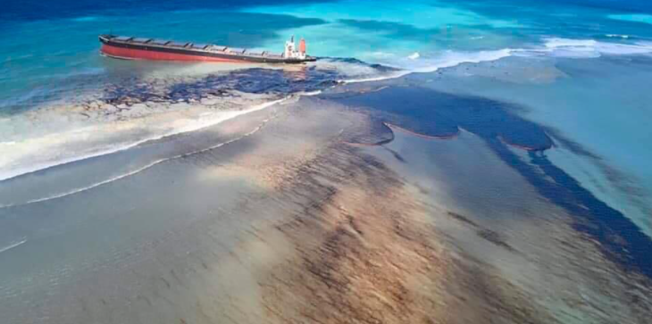
Introduction
Contamination of seawater due to an oil pour, as a result of an accident or human error, is termed an oil spill.
As oil is unevenly distributed, it is transported by ships across the oceans and by pipelines across the lands. This has resulted in several accidents in the past while transferring the oil to vessels, during transportation, breaking of pipelines, as well as while drilling in the earth’s crust.
Crude oil is a mixture of gas, naphtha, kerosene, light gas, and residuals, which causes hazardous health effects if consumed by any life forms.
Oil spills contaminate the coasts and estuaries and can cause serious health problems to human beings.
marineinsight.com

Slide 3
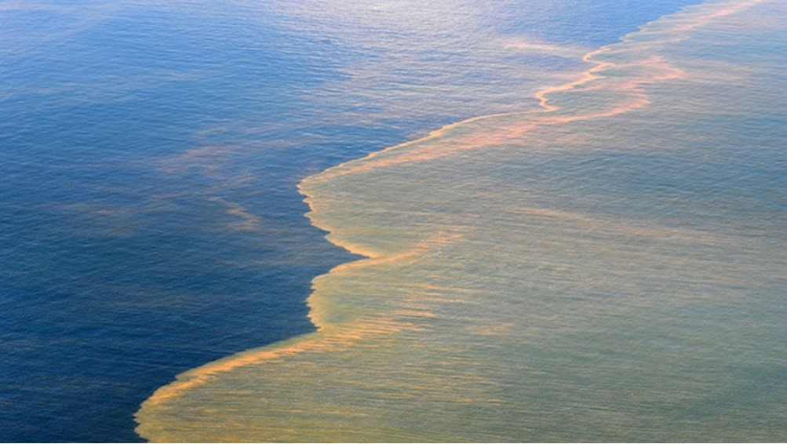
Motivation
The biggest threat to the safe marine environment is “oil spill” from ships.
Its high time that we realize how important is the individual participation and to educate themselves about the adverse effects of oil spill.
The aim is to bring awareness about water pollution due to oil spill and the ways it is affecting us.
Fossil fuels are high in demand and are depleting at a very fast rate, it is our duty to use them sustainably. Oil spills are such a waste of valuable resources and deplete the marine life so it is necessary to learn to prevent it at all costs.

Slide 4
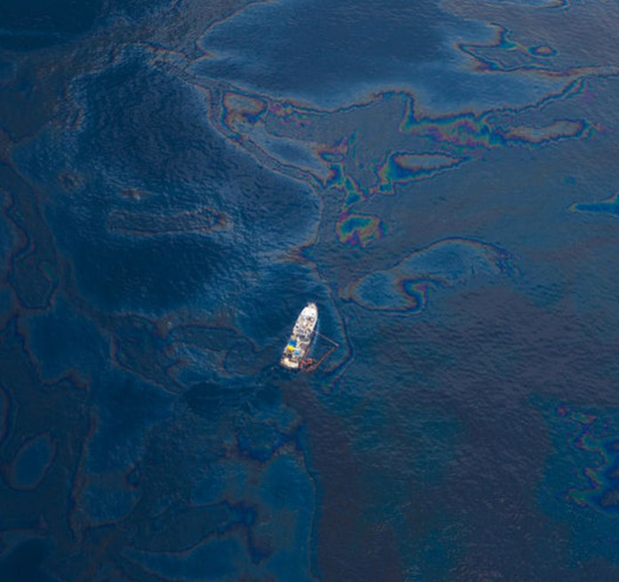
Causes
Natural spills - Crude oil is formed during long periods of time through natural processes involving organic matter from dead organisms. Oil exists in many environments and may be naturally spilled due to various factors (including climatic conditions, disturbance, etc.). Such natural oil spills may occur in oceans, due to eroding of sedimentary rocks from the bottom of the ocean (the effect may be similar with that of an accidental oil spill from human drilling in oceans such as the recent BP oil spill from the Gulf of Mexico).
Anthropogenic causes - It includes accidental oil spills (such as the BP oil spill in the Gulf of Mexico) as well as leaks and spills due to a large variety of human activities related to oil refining, handling and transport, storage and use of crude oil and any of its distilled products.
Thousands of minor and several major oil spills related to well discharges and tanker operations are reported each year, with the total quantity of oil released annually into the world’s oceans exceeding one million metric tons. The unintentional or negligent release of used gasoline solvents and crankcase lubricants by industries and individuals greatly aggravates the overall environmental problem. Combined with natural seepage from the ocean floor, these sources add oil to the world’s waterways at the rate of 3.5 million to 6 million metric tons a year.

Slide 5
Largest Oil tanker spills in history
SHIP NAME | Spill(Metric Ton)
Atlantic Empress(1979) | 2,87,000
ABT Summer(1991) | 2,60,000
Castrilla de Bellver(1983) | 2,52,000
Amoca Cadiz(1978) | 2,23,000
Jakab Maersk (1975) | 88000
Independenta(1979) | 95000
Hawaiian Patriot(1977) | 95000
Urquiola(1976) | 100000
Irenes Serenade(1980) | 100000
Sea star(1972) | 115000
Tarrey Canyon(1967) | 119000
Odyssey(1988) | 132000
Haven(19991) | 144000
Braer(1993) | 85000
KharK 5(1989 | 80000
Aegan sea (1992) | 74000
Sea Empress(1996) | 72000
Nova(1985) | 70000
Katina P(1992) | 66700
Prestige(2002) | 63000
Safety4sea.com
Sciencedirect.com

Slide 6
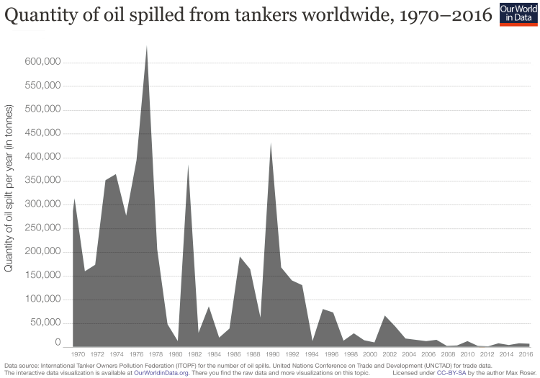
Oil Spilled per year
Over these 43 years, the annual quantity of oil spilled decreased hugely. In the 21st century the quantity of spilled oil was smaller than in several single years in earlier decades. 2012 saw the lowest oil spillage on record so far: 1000 tonnes were spilled. The development can be seen in the given visualization.
Since the mid-1980s, seaborne oil trade has been increasing while the number of oil spills is decreasing. This makes clear that the decrease in oil spills is not due to a decrease in oil trade. On the contrary the share of oil that is not reaching its destination is falling very strongly and is small today.
ourworldindata.org

Slide 7
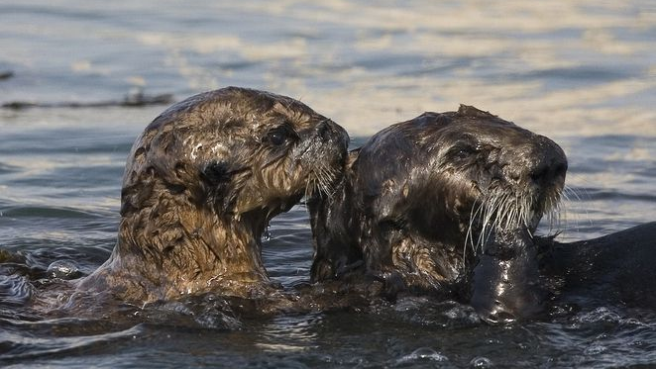
Effects of Oil Spill
LAND:A lot of toxins are flushed into the atmosphere. When the oil is spilled, the soil absorbs it. This in turn, mixes with the water table below. The natural vegetation, agriculture, plants, shrubs and even trees get affected as they absorb this toxic water from beneath. Thus, the whole area becomes infertile.
AIR: The natural habitat of the birds, their nesting and breeding grounds gets disrupted due to the oil spill. The birds sometimes get coated with oil which makes them vulnerable to hypothermia (fluctuations in body temperature) and reduces their ability to fly. Their prey also gets coated with oil which when consumed by the birds causes damage to its internal organs leading to its death.
WATER: Since most of the oil after an oil spill floats on water, the sunlight absorbing capacity of the water decreases. Thus, the oxygen withholding capacity and the percentage of oxygen in water decreases. This affects the marine animals as there is less oxygen in water. The immunity of the marine animals reduces, leading to its death. The reproductive capacity of the females diminishes which can lead to the extinction of the species. Marine mammals like whales and dolphins also get affected as oil clogs their blowholes, making it impossible for the animals to breathe. Their ability to communicate also gets affected due to oil spill. Most of the plants get affected due to oil spills and they vanish from the ocean bed. This affects the global food chain.
Offshore-technology.com

Slide 8
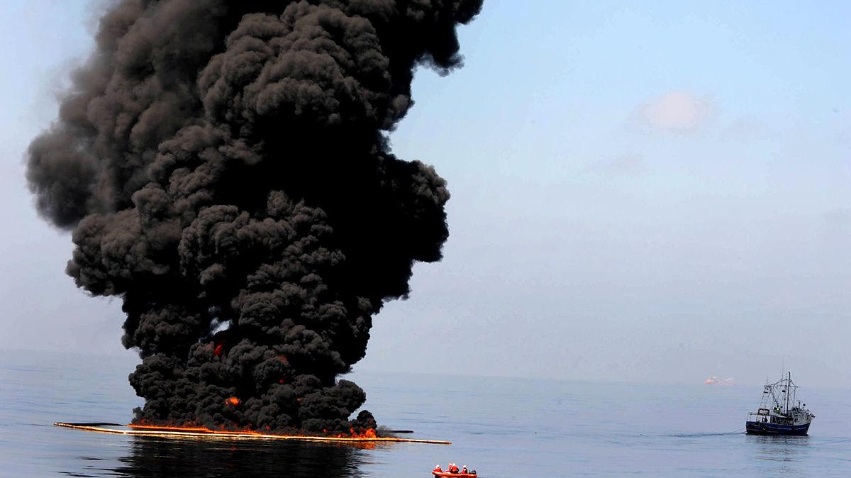
HUMANS AND WILDLIFE: The contamination of local ecosystems can impact communities who rely on said ecosystems to survive, with crops and food sources becoming poisonous or disappearing altogether as a result of food chains being destabilized.
Water supplies in surrounding areas are at risk of contamination from oil spills. Fishermen and local ship workers can lose their sources of income due to the health problems associated with exposure to oil, such as respiratory damage, decreased immunity and increased cancer risk. This could deprive communities of essential resources and revenue needed to support them.
Oil spills can affect the air quality in surrounding areas, releasing toxic chemicals into the atmosphere. Following the 2010 Deepwater Horizon disaster, a 2015 case study found concentrations of benzene and fine particulate matter around southeast Louisiana that were “high enough to exceed public health criteria, with measurable exposure disparities in the coastal areas closer to the spill and clean-up activities.”
A 2019 study in Nigeria, Africa’s most populous country and largest oil producer, discovered that nearby oil spills increased neonatal mortality by 38.3% per 1,000 live births. Further evidence suggesting these effects persist for several years after an oil spill takes place, with the study describing the impact as “an alarming ongoing human tragedy.”
Offshore-technology.com

Slide 9
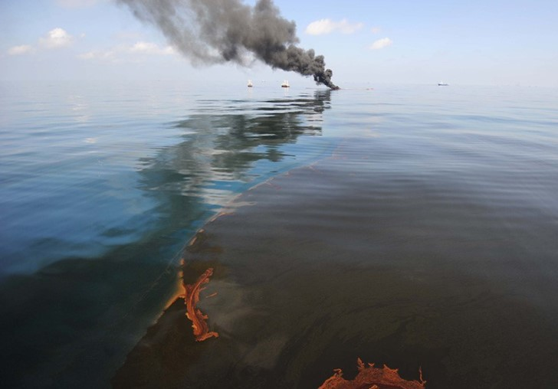
BP DEEPWATER HORIZON OIL SPILL:CASE STUDY
It was Largest accidental spill in the world.
The well spilled 3.19 million barrels of oil into the waters of the Gulf and onto the shorelines of Florida, Alabama, Mississippi, Louisiana, and Texas.

Slide 10
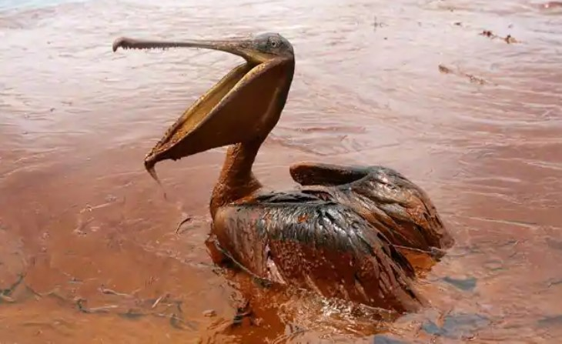
It was Largest accidental spill in the world.
The well spilled 3.19 million barrels of oil into the waters of the Gulf and onto the shorelines of Florida, Alabama, Mississippi, Louisiana, and Texas.
CAUSE:
Explosion in British Petroleum's Deepwater Horizon oil drilling rig in the Gulf of Mexico on April 20, 2010.
CLEANUP AND RESTORATION:
Manually removed: Sheen on the state’s marshes and estuaries. Oil and tar balls had made landfall on the beaches of Mississippi, Alabama, and Florida. In all, an estimated 1,100 miles (1,770 km) of shoreline were polluted.
Skimmers: Boats that skim spilled oil from the water's surface, through the slick. Only about 2-4 percent of the oil was recovered by using skimming.
Sorbents: Absorbs and adsorbs oil. They come in three main types: natural organic materials like peat moss, straw, hay, and sawdust; natural inorganic materials like clay, volcanic ash, sand, or vermiculite; and synthetic sorbents made of materials similar to plastic like polyurethane, polypropylene, and polyethylene.
Burning: Another option was to burn the oil away. About 5 to 6 percent of the oil from the Deepwater Horizon oil spill was removed by controlled burning.
Dispersants: Chemicals that break down the oil into smaller particles that mix with water more easily—to prevent them from forming. The clean-up workers treated the oil with over 1.4 million gallons of various chemical dispersants.
Even after all the clean-up efforts, there are still traces of oil available.
SOURCE : Britannica, epa.gov

Slide 11
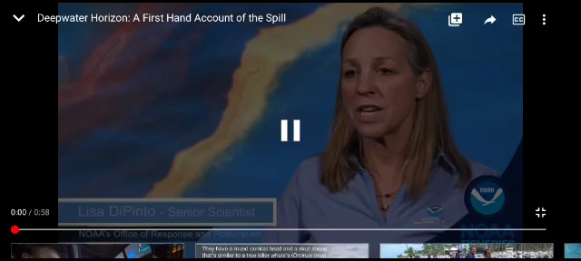
Source: YouTube-NOAA Fisheries

Slide 12
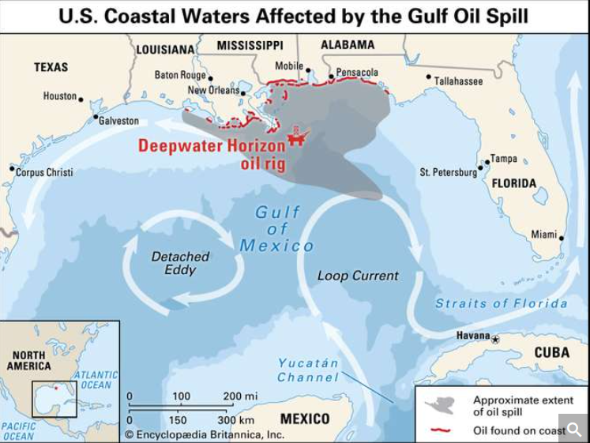

EFFECTS:
That explosion resulted in 11 deaths and the release of millions of barrels of crude into the Gulf over 87 days. The well was capped on July 15, 2010.
The spill devastated the invertebrates, fishing and tourism industries of the Gulf Coast region.
Over 8,000 animals (birds, turtles, mammals) were reported dead just 6 months after the spill, including many that were already on the endangered species list. Strandlines of both dolphins and sea turtles increased and up to 167,600 turtles die because of the spill.
Reduced marine oxygen levels., Oil fell on the ocean floor, remained in the food chain for a very long time.
Life in the deep sea was exposed to the dispersant-oil mixture. Any bits of the mixture that didn't get broken down would then get buried in coastal and deep-sea sediments, where its breakdown slowed.
A formal civil and criminal investigation into the spill was initiated in June 2010 by the U.S. Department of Justice (DOJ).
CONCLUSION:
The spill opened many people’s eyes to the risks of drilling for oil in one of the most ecologically rich, culturally important, and economically valuable parts of the world. It made people realize how difficult a situation can become if not worked out properly. They started to conserve resources and care for the habitat.
SOURCE: epa.gov, Britannica

Slide 13
Cleaning of oil spills
Skimmers: Skimmers are machines specially designed to suck up the oil from the water surface like a vacuum cleaner. They are used to physically separate the oil from the water so that it can be collected and processed for re-use.
Sorbents: Sorbents are materials that soak up liquids by either or adsorption. Both these properties make the process of clean-up much easier. Materials commonly used as oil sorbents are hay, peat moss, straw or vermiculite.
Burning In-situ: In this method, the oil floating on the surface is ignited to burn it off. This in-situ burning of oil can effectively remove up to 98% of an oil spill, which is more than most of the other methods.
Hot Water and High-Pressure Washing: Water heaters are used to heat up water to around 170°C, which is then sprayed by hand with high-pressure wands or nozzles. The oil is thus flushed to the water surface, which can be collected with skimmers or sorbents.
marineinsight.com

Slide 14
Using Dispersants: Dispersal agents, such as Corexit 9500, are chemicals that are sprayed upon the spill with the help of aircraft and boats, which aid the natural breakdown of oil components. They allow the oil to chemically bond with water by increasing the surface area of each molecule. This ensures that the slick does not travel over the surface of the water and is easier to degrade by microbes.
Using Manual Labour: It involves the use of manual means like hands, rakes, shovels etc. to clean the surface oil and oily debris and place them in special containers to be removed from the shoreline.
Bioremediation: There are various classes of bacteria, fungi, archaea and algae that degrade petroleum products by metabolizing and breaking them into simpler and non-toxic molecules (mostly fatty acids and carbon dioxide). Sometimes, reagents and fertilizers may be added to the area.
Chemical Stabilization of oil by Elastomers : Quite recently, experts have been using compounds like ‘Elastol’, which is basically poly iso-butylene (PIB) in a white powdered form, to confine oil spills. The compound gelatinizes or solidifies the oil on the water surface and thus keeps it from spreading or escaping.
Natural Recovery: The simplest method of dealing with the oil spill cleanup operation is to make use of the vagaries of nature like the sun, the wind, the weather, tides, or naturally occurring microbes.
marineinsight.com

Slide 15
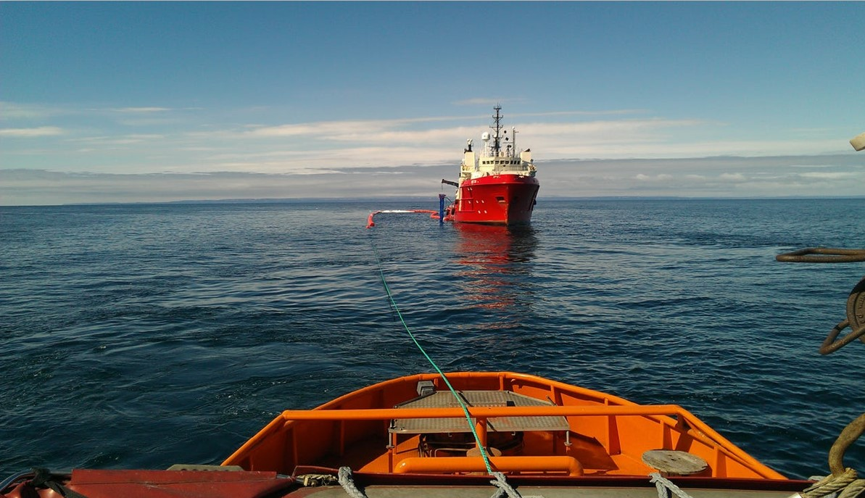
Prevention from oil spills
Double-hulling - Build double hulls into vessels, which reduces the risk and severity of a spill in case of a collision or grounding. Existing single-hull vessels can also be rebuilt to have a double hull.
Secondary containment – Method to prevent releases of oil or hydrocarbons into environment.
Blowout Preventer – It is a specialized valve or similar mechanical device, used to seal, control and monitor oil and gas wells to prevent blowouts, the uncontrolled release of crude oil or natural gas from a well.
Stronger well castings in carriers.
The ship engines should be equipped with dripping pan or cookie sheet (or oil tray). There should be ample oil absorbent pads to soak discharge of oily water. Defected parts and fittings should be replaced before their complete failure. Lines can fail due to severe heat and water exposures.
Making shipping safer – By training the crew properly and educating about
Interpretation of radar and satellite
Up to date information on changing weather conditions
noa.gov

Slide 16
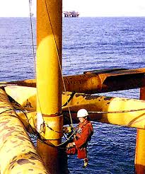
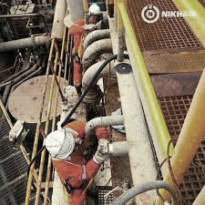
Precautions From Oil Spills
To prevent the spill from reaching shore
To reduce the impact on marine life
To speed the degradation of any unrecovered oil.
Weather permitting, booms can be used to contain or divert the spilled oil, which may then be recovered using skimmers or burned off. However, if winds or waves are too high, booms will be ineffective and will not provide adequate containment of the spill.
Dispersants, applied to the spill via aircraft, can be effective in breaking up spills of light- or medium-density oils. Dispersant use is also contingent upon weather, as high winds make it difficult to accurately target the spill from the air. Sorbents may be used for small-volume spills, or as a final "polish" after other response options have been used.
Oilspillresponse.com

Slide 17
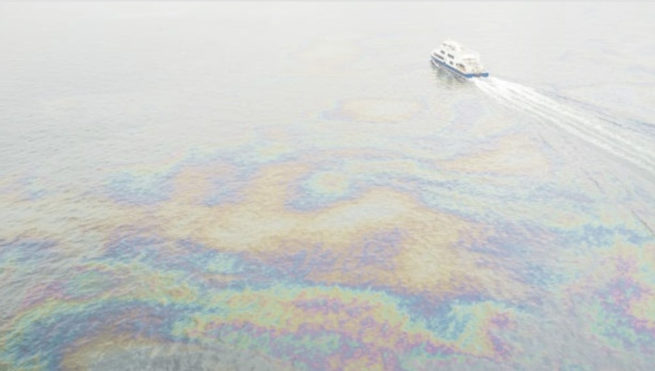
Conclusion
The tracking, containment, and recovery of spills of non floating oils pose challenging problems, principally because non floating oils suspended in the water column become mixed with large volumes of seawater and may interact with sediments in the water column or on the seabed. The ability to track, contain, and recover non floating oils is critically dependent on the physical and chemical properties of the oils and the water or the oils and the other materials dispersed in the water column or on the seabed. The differences in these characteristics are often quite small, and little technology is available for determining them.
Engineered systems for containing oil in the water column or on the seabed are few and only work in environments with low currents and minimal waves. Natural containment in seabed depressions or in the lee of topographical or man-made structures on the seabed is effective for containing oils, but these are not always available in the vicinity of the spill.
nap.edu

Slide 18
THANKYOU

